Slide 1


DOEHRS-HC User Creation Practicum
Tri-Service Hearing Technician
4.2 Certification Course

Slide 2
DOEHRS-HC User Creation Practicum
Learning Objectives
1.3.1 Understand Software used to enter DoD Hearing Conservation Audiograms
1.3.2 Create a DOEHRS-HC user identity
1.3.3 Understand the different user privileges/restrictions
1.3.4 Select correct user privilege
1.3.5 Understand vital examiner fields
1.3.6 Enter examiner information correctly
1.3.7 Understand how to unlock accounts
1.3.8 Understand how to clear passwords
Tri-Service Hearing Technician 4.2 Certification Course

Slide 3
DOEHRS-HC Defense Occupational and Environmental Health Readiness System – Hearing Conservation
DOEHRS-HC is the Military Services system of record for conducting monitoring audiometry
DOEHRS-HC consists of:
  Desktop database software
  Microprocessor Audiometer hardware and software (Benson Medical Instruments CCA-200)
  Web-based data repository
All monitoring audiometry for the Military Services personnel will be recorded in DOEHRS-HC
Tri-Service Hearing Technician 4.2 Certification Course
Notes:
DOEHRS-HC consists of sub-fields (examiner information, UIC/WICs, audiometers, listeners) that are associated with multiple records and are required to be filled out correctly; current fields are individually associated with a patient record(s); Correct user/examiner required to be logged into software.

Slide 4

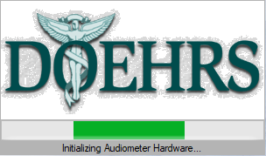
DOEHRS-HC User Creation Practicum
DOEHRS-HC Application Access
DOEHRS-HC is integrated with the audiometer testing software application
DOEHRS-HC ICON
  Acknowledge DOD notice and consent banner
  Resolve any audiometer error messages prior to continuing
An HCPM user needs to log in to add additional users into the database
Resolve any CCA-200 error messages
Only authorized certified technicians can perform audio testing and are required to test under their user identity
  Completed DOEHRS-HC certification course
Tri-Service Hearing Technician 4.2 Certification Course
Notes:
Initializing audiometer hardware window, several pop-up prompts and/or error messages may appear when the application opens, read/become familiar with them and resolve them prior to continuing
Most common error message, hardware connections, power is off or interface cable is disconnected
Ensure to always turn off power prior to connecting/disconnecting audiometer from the computer or each other
Add user identity into each DOEHRS-HC work station where audio testing/DOEHRS data entry will be performed

Slide 5
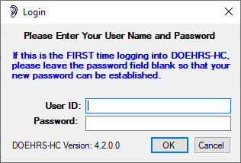
DOEHRS-HC User Creation Practicum
DOEHRS-HC Application Access
There are 3 HCPM users in the local DOEHRS-HC
  SMITHA
  SMITHAF
  SMITHN
Log in using User ID ________
Tri-Service Hearing Technician 4.2 Certification Course
Notes:
Have all students choose the same user identity
Read prompts that appear with log-in, if there are audiometric errors bring it to the facilitators attention;
Ensure all students have only 3 users in their database, any more/less then the initial student database is not installed, close DOEHRS-HC and immediately replace database with the correct one.
Sub-fields affect multiple records and have to be filled out correctly, if the examiners information is filed out incorrectly it will affect all records that the user creates.
Have students go to File>Users, all training databases should have 3 HCPM users in it, more or less than 3 then the incorrect “initial student database” is present, replace it with the correct database.
Note: additional functions under users: lock/unlock account, clear password, delete user - just makes user inactive, once created, examiner information will never be fully deleted

Slide 6
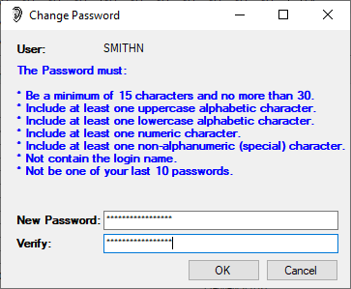
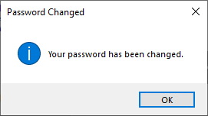
DOEHRS-HC User Creation Practicum
DOEHRS-HC Application Access
Enter user name
Do not enter a password
Press OK
New/Verify password = Qwerty1234567890_
Tri-Service Hearing Technician 4.2 Certification Course
Notes:
Have students log in using a specific user ID, do not type in a password; enter/verify Qwerty1234567890_ in change password window

Slide 7
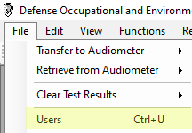
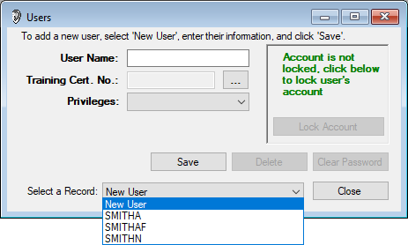
DOEHRS-HC User Creation Practicum
DOEHRS-HC HCPM User Login
An HCPM user has to be logged into the DOEHRS-HC work station in order to add yourself as a new DOEHRS-HC user
User identity needs to be created on each DOEHRS-HC work station
Always log in under your own user identity
Verify 3 users in current work station
Tri-Service Hearing Technician 4.2 Certification Course
Notes:
Read prompts that appear with log-in, if there are audiometric errors bring it to the facilitators attention;
Ensure all students have only 3 users in their database, any more/less then the initial student database is not installed, close DOEHRS-HC and immediately replace database with the correct one.
Sub-fields affect multiple records and have to be filled out correctly, if the examiners information is filed out incorrectly it will affect all records that the user creates.
Have students go to File>Users, all training databases should have 3 HCPM users in it, more or less than 3 then the incorrect “initial student database” is present, replace it with the correct database.
Note: additional functions under users: lock/unlock account, clear password, delete user - just makes user inactive, once created, examiner information will never be fully deleted

Slide 8
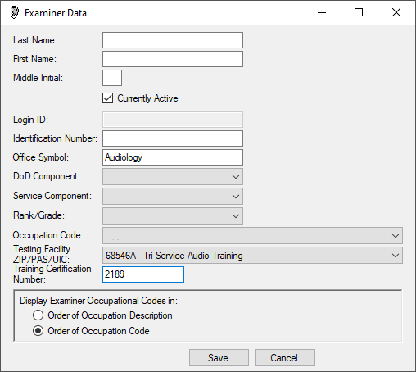
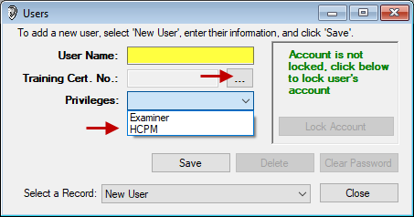
DOEHRS-HC User Creation Practicum
Create DOEHRS-HC User/Examiner Sub-Fields
User name = last name
Select HCPM privilege
Enter correct examiner data
  ID# = SSN linked with certification number
  DoD Comp filters testing facility selections
Tri-Service Hearing Technician 4.2 Certification Course
Notes:
This is a sub-field, any mistakes will be multiplied by the number of audiograms done by this user.
Bottom line: make sure these fields are filled out correctly
To add user, ensure New User is selected
Type in last name as the user name
Privilege = HCPM
Note: Throughout DOEHRS-HC previously selected drop down windows limit future drop down window selections; always use the tab to advance to the next field, do not skip fields
Enter examiner data, office symbol = work location
For training purposes all students select 68546A as their test site.
Review for future use, testing facility is as follows:
USA examiners uses zip code of the audio booth; USAF uses examiners PAS code as testing facility; USN/USMC uses UIC of the test booth location.
Use 2189 as the course number, followed by 2-5 digits depending on service providing audio course with the sponsoring service letter at the end of the certification number:
A = Army; F = Air Force; N = Navy

Slide 9
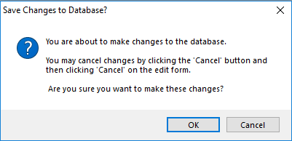
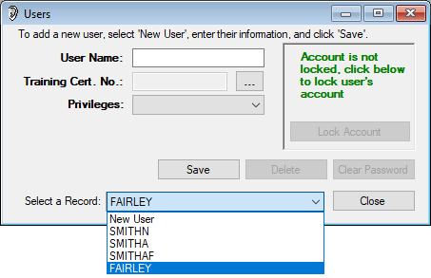
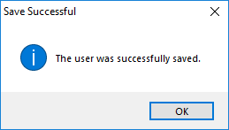
DOEHRS-HC User Creation Practicum
Saving DOEHRS-HC User/Examiner Sub-Fields
Ensure data is correct prior to saving user/examiner
Once saved ensure 4 examiners are present in the user drop down window
Tri-Service Hearing Technician 4.2 Certification Course
Notes:
Resolve any errors

Slide 10
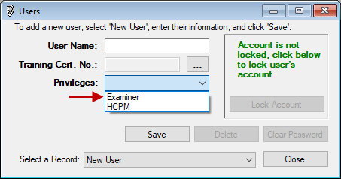
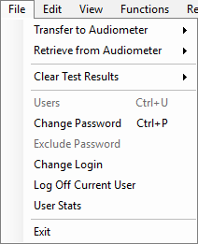
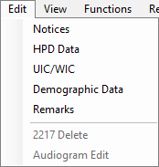
DOEHRS-HC User Creation Practicum
DOEHRS-HC Examiner Privileges
Fields unavailable under examiners privileges
Tri-Service Hearing Technician 4.2 Certification Course
Notes:
Examiner role is restrictive, following areas are inaccessible: users, exclude password, 2217 delete, audiogram edit, audit train report
Most important: users with examiner privileges can’t add, edit, unlock, clear user’s password or edit any audiograms

Slide 11
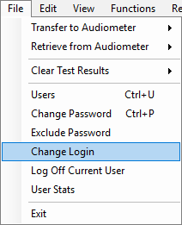
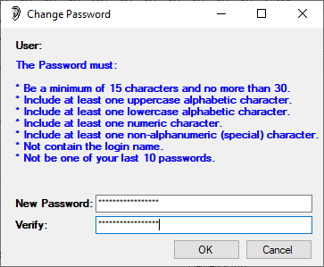
DOEHRS-HC User Creation Practicum
DOEHRS-HC Change Login/User
Enter User ID
PW = Qwerty1234567890_
Do not attempt to login more than one time
Tri-Service Hearing Technician 4.2 Certification Course
Notes:
Have the students log in, use password Qwerty1234567890_ one time only (this is to demonstrate the login failure)
All students should try this only once, show the Invalid user name/password prompt displayed on the next slide
Password is case sensitive, ensure caps lock is not engaged

Slide 12
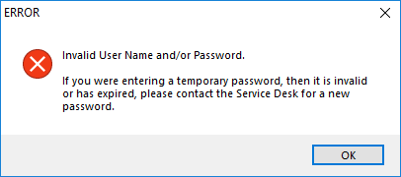
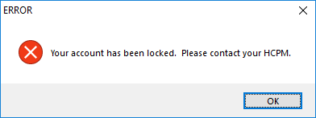
DOEHRS-HC User Creation Practicum
DOEHRS-HC Change Login/User
Any 3 consecutive DOEHRS-HC access attempts with an invalid password will lock your account
Passwords expire every 60 days
Cleared passwords never expire
Tri-Service Hearing Technician 4.2 Certification Course
Notes:
All students should try this only once, show the Invalid user name/password prompt, inform everyone that you can only try to access DOEHRS-HC and the DR but on the third consecutive invalid try, the application will lock user’s accounts; for DOEHRS-HC another HCPM user can unlock/clear the password of the user or the user can contact the DHA help desk for a temporary password
Password expires every 60 days; previous 10 passwords cannot be used
Clear password if you will not be using the DOEHRS-HC system for an extended period of time

Slide 13
DOEHRS-HC User Creation Practicum
DOEHRS-HC Change Login/User
Enter User ID/no password press OK
PW = Qwerty1234567890_
Functions>Run Test/CCA-200
Resolve any audiometer error messages prior to continuing
Tri-Service Hearing Technician 4.2 Certification Course
Notes:
Always log in under your own user identity, use above password; remind again password is case sensitive
Students: for the remainder of the class always log in under your user ID/examiner
Use menu to bring up the Run Test and CCA-200 windows

Slide 14
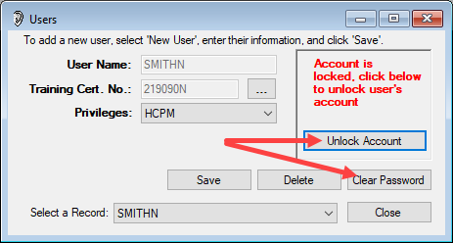
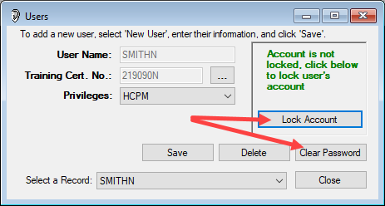
DOEHRS-HC User Creation Practicum
DOEHRS-HC Unlock Account/Clear Password
Any HCPM on the local database can unlock and clear passwords
Tri-Service Hearing Technician 4.2 Certification Course
Notes:
Always log in under your own user identity, use above password; remind again password is case sensitive
Students: for the remainder of the class always log in under your user ID/examiner
Use menu to bring up the Run Test and CCA-200 windows

Slide 15
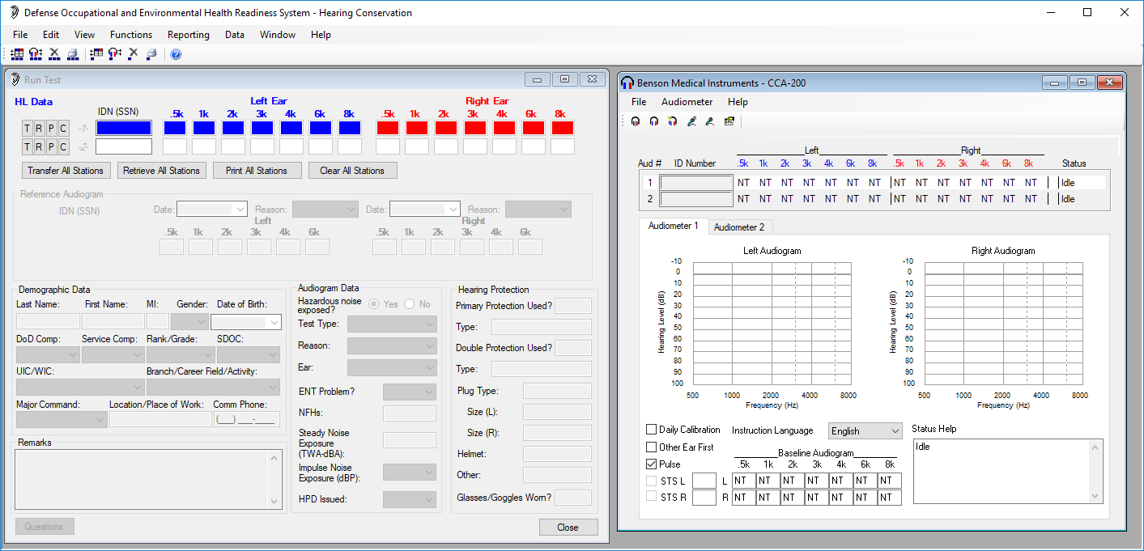
While in training always arrange your DOEHRS-HC desktop as displayed
Notes:
Standardization of students desktop makes it easier for the instructors to visually see that all are students are on the correct window/DOEHRS-HC location. Also some smaller desktop screens may overlap the DOEHRS-HC/CCA-200 window; the tech needs to view the right side of the CCA-200 window for any status problems.

Slide 16
DOEHRS-HC User Creation Practicum
Summary
DOEHRS-HC application/software description
DOEHRS-HC user creation
Examiner versus HCPM privileges
Vital examiner fields
Examiner data entry
Unlock user accounts
Clear user passwords
Tri-Service Hearing Technician 4.2.0.0 Certification Course

Slide 17
DOEHRS-HC User Creation Practicum
? Questions ?
Tri-Service Hearing Technician
4.2 Certification Course

